Slide 1
Food Mart
Media Cost Prediction &
Customer Segmentation

Slide 2
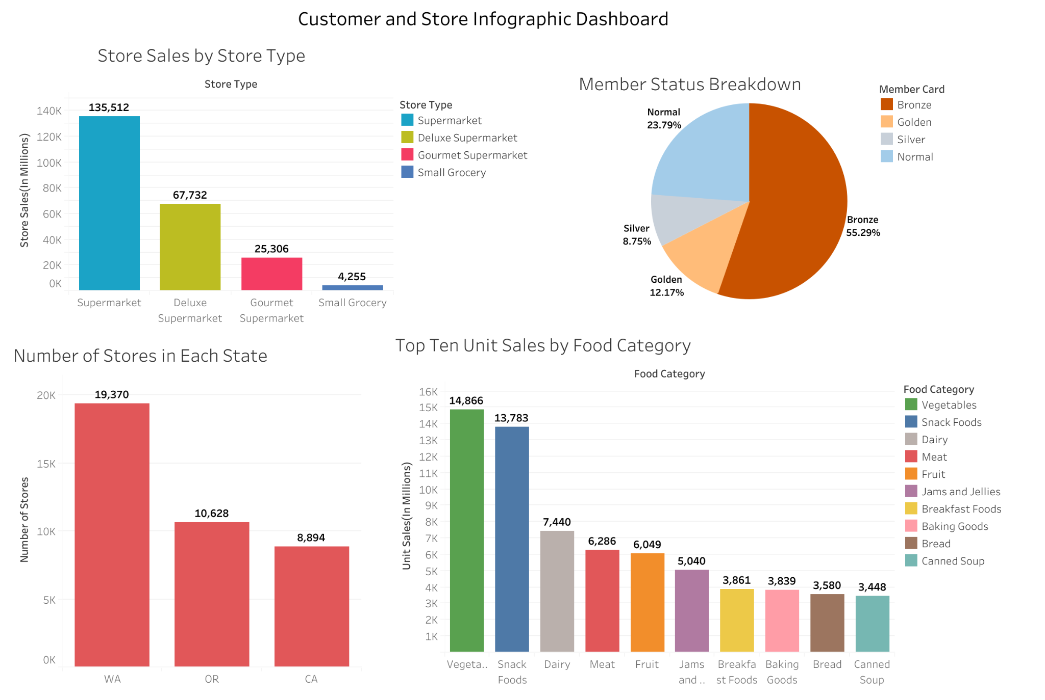
Data Visualizations
What are the demographics?
What are the top selling foods?
Top store types by sales?
Notes:
This dashboard answers some questions such as
More visualizations will be added/finalized per our results and findings…

Slide 3
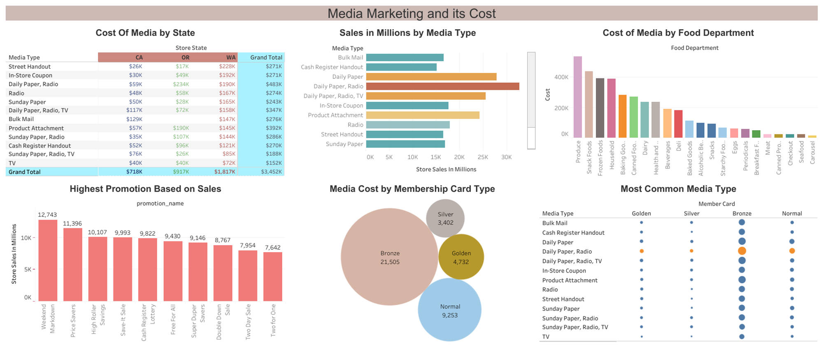
Data Visualizations Media Marketing and its cost
Data was used to predict Media Cost; the dashboard represents the cost of media for a Food Marts in 3 states. Also, the cost of media on its different categories. Visualizations will be updated as per our findings and to answer all our questions.

Slide 4
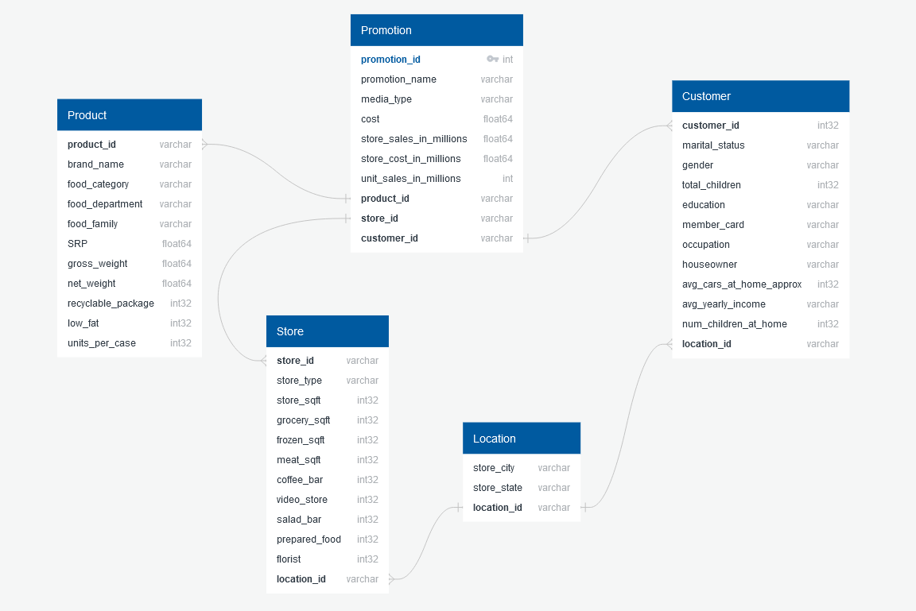
DataBase
Database : SQL
SQL - > Jupyter Notebook
5 Tables
Joins to create new Tables
Foreign Key Columns

Slide 5
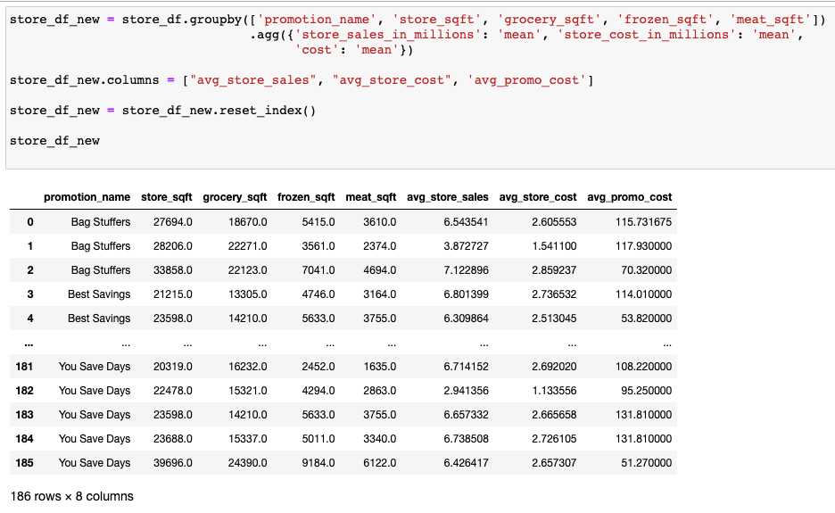
Machine Learning Overview
ML Models have been re-fit to evaluate the separate tables described in our updated Database ETL
1
Aggregation Example
This week’s goal was to explore the effect, if any, that grouping & aggregating variables may have on our ML models
2

Slide 6
Homepage
Project Overview
Summary
About FoodMart
Data Source
Model
Database
Visualization
About Us
Wikipedia
Machine learning codes
GitHub links
Tableau dashboard
Dataset Sample
Filter search
Kaggle dataset
Team member
social media
Code for building tables
GitHub link
New Tables
Stored in GitHub

Slide 7
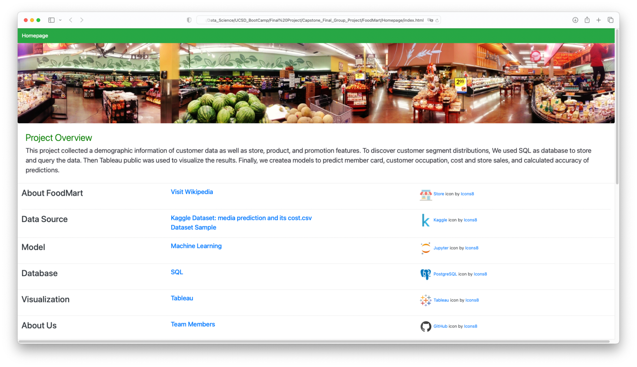
https://minhaskamal.github.io/DownGit/#/home?url=https:%2F%2Fgithub.com%2Fbpiffard%2FCapstone_Final_Group_Project%2Ftree%2Fceline%2FFoodMart
Webpage library

Slide 8
Team
Stella Kahachatryan
Gian Marcelin
Carlos Morales
Berns Piffard
Celine Wang
Hilda Hernandez
CFO
Sales Director
CEO
Vinny Viewer
Wendy Writer

Slide 9
Thank you.

